Slide 1
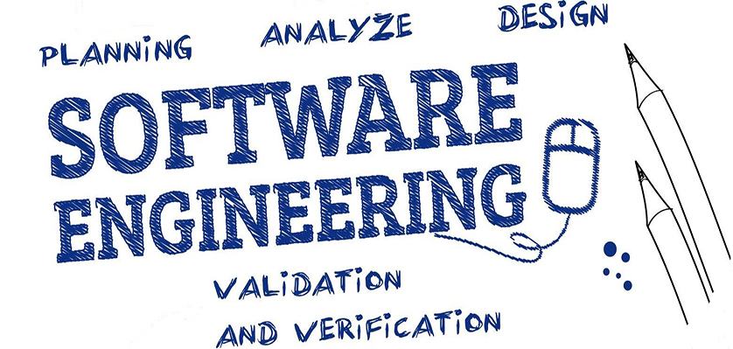
PART-III
Software Engineering (SE) → CSEN3202 – CSE/BTech/6th Semester → Module-I → Prepared by : Nilina Bera, CSE, HITK

Slide 2
Software Life Cycle Models
A life cycle model prescribes the different activities that need to be carried out to develop a software product and the sequencing of these activities.
The software life cycle is also referred to as Systems Development Life Cycle (SDLC).
The software lifecycle can be considered as the business process for software development;
Thus s/w life cycle is often referred to as a software process.
Nilina Bera

Slide 3
Software Life Cycle Models
The series of identifiable stages that a software product undergoes during its lifetime are:
    Feasibility study
    Requirements analysis and specification,
    Design,
    Coding,
    Testing
    maintenance
A software life cycle model (or process model):
  a descriptive and diagrammatic model of software life cycle
  identifies all the activities required for product development,
  establishes a precedence ordering among the different activities,
  Divides life cycle into phases.
Nilina Bera

Slide 4
Software Life Cycle Models
Several different activities may be carried out in each life cycle phase. For example, the design stage might consist of:
    Structured analysis activity (DFD model) followed by
    Structured design activity (Structured Chart).
Every software development process model takes requirements as input and delivers products as output.
A process should detect defects in the phases in which they occur.
This required Verification & Validation (V&V) of the products after each and every phase of software development life cycle (SDLC).
Nilina Bera

Slide 5
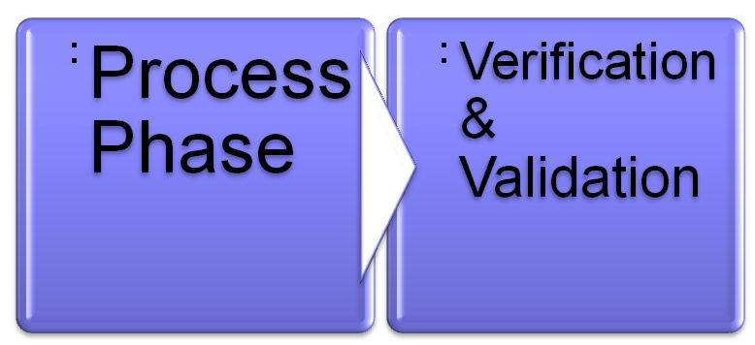
Software Life Cycle Models
Input
Output
Requirements
Products
Verification: IEEE defines verification as a process for determining whether the software products of an activity fulfill the requirements or conditions imposed on them in the previous activities.
Validation: IEEE defines validation as a process for determining whether the requirements and the final, as-built system or software product fulfills its specific intended use.
Nilina Bera

Slide 6
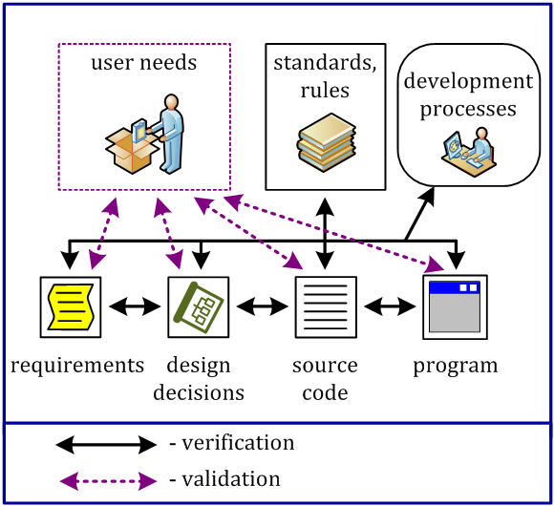
Verification and Validation
Verification answers the question "Are we making the product properly?" while validation - "Are we making a proper product?"
Nilina Bera

Slide 7
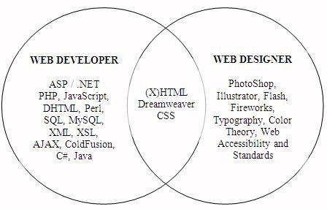
Validation aims to make sure that data is sensible, reasonable and ......
Allowable
Accurate
Accessible
Accurate
Ans: 1. Allowable
https://www.abeautifulsite.net/the-difference-between-web-designers-and-web-developers
Nilina Bera

Slide 8
SDLC….. Want to know more on V & V ????
The tools that support different stages of software development life cycle are called:
(A) CASE Tools (B) CAME tools (C) CAQE tools (D) CARE tools
Ans: A
CASE stands for Computer Aided Software Engineering. It means, development and maintenance of software projects with help of various automated software tools.
Validation is the same as verification, they work the same way. True or false?
Ans: False
Which type of validation would check that you had only put a number into a field with a 'numeric' data type?
Presence check 2. Type check
3. Check digit 4. Range check
Ans: Type Check
Which type of validation would you use to ensure that data is entered into a field and that it can't be left blank?
1. Type check 2. Range check 3. Presence check 4. Check digit
Nilina Bera
Ans: Presence check

Slide 9
SDLC….. Want to know more on V & V ????
Which type of validation would be the best if you wanted to check that a series of numbers you had entered was correct?
1. Presence check 2. Type check 3. Check digit 4. Range check
Ans: 3. Check digit
Verification checks that the data that you entered is correct. True or false?
Ans: False. Verification means checking the data you have entered against the original source document.
When you choose a new password and have to enter it twice, is this validation or verification?
1. Validation 2. Verification
Ans: Verification
Nilina Bera

Slide 10
Software Life Cycle Models
Many life cycle models have been proposed. We will confine our attention to a few important and commonly used models.
  Classical waterfall model
  Iterative (relaxed) waterfall,
  Evolutionary or incremental,
  Prototyping, and
  Spiral model
  Agile model
  RAD
Nilina Bera

Slide 11
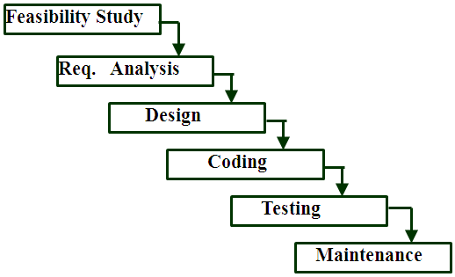
Classical Waterfall Model
The classical waterfall model can be considered as the basic model and all other life cycle models are kind of uses the classical waterfall model as the building block for their inception. Enhancement of Classical Waterfall → Iterative waterfall model is the most widely accepted life cycle model so far.
Nilina Bera

Slide 12
Iterative Waterfall Model
Classical waterfall model is idealistic:
  assumes that no defect is introduced during any development activity.
In practice: defects do get introduced in almost every phase of the life cycle.
Defects usually get detected much later in the life cycle:
  For example, a design defect might go unnoticed till the coding or testing phase.
Once a defect is detected:
  we need to go back to the phase where it was introduced
  redo some of the work done during that and all subsequent phases.
Therefore we need feedback paths in the classical waterfall model.
Nilina Bera

Slide 13
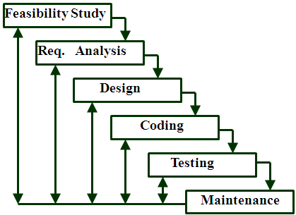
Iterative Waterfall Model
Nilina Bera

Slide 14
Phase containment of errors
Reason: rework must be carried out not only to the design but also to code and test phases.
The principle of detecting errors as close to its point of introduction as possible is known as phase containment of errors.
Phase containment in a nutshell is finding and removing bugs/defects early in the process of SDLC. It is the act of containing faults in one phase of software development before they escape and are found in subsequent phases. An error is a fault that is introduced in the current phase of software development.
Nilina Bera

Slide 15
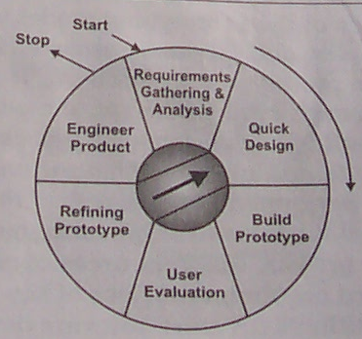
Prototyping Model
Nilina Bera

Slide 16
Software Life Cycle Models
Before starting actual development,
  a working prototype of the system should first be built.
A prototype is a toy implementation of a system:
  limited functional capabilities,
  low reliability,
  Inefficient performance.
Nilina Bera

Slide 17
Reasons for developing a prototype
Illustrate to the customer:
  input data formats, messages, reports, or interactive dialogs.
Examine technical issues associated with product development:
  Often major design decisions depend on issues like:
response time of a hardware controller, efficiency of a sorting algorithm, etc.
Nilina Bera

Slide 18
Software Life Cycle Models
The third reason for developing a prototype is:
  it is impossible to ``get it right'' the first time,
  we must plan to throw away the first product
    if we want to develop a good product.
Start with approximate requirements.
Carry out a quick design.
Prototype model is built using several short-cuts:
  Short-cuts might involve using inefficient, inaccurate, or dummy functions.
    A function may use a table look-up rather than performing the actual computations.
The developed prototype is submitted to the customer for his evaluation:
  Based on the user feedback, requirements are refined.
  This cycle continues until the user approves the prototype.
The actual system is developed using the classical waterfall approach.
Nilina Bera

Slide 19
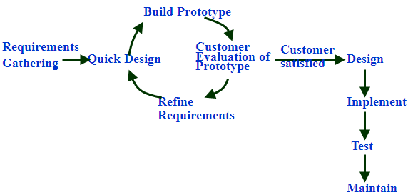
Software Life Cycle Models
Nilina Bera

Slide 20
Evolutionary Model
Evolutionary model (aka successive versions or incremental model):
  The system is broken down into several modules which can be incrementally implemented and delivered.
First develop the core modules of the system.
The initial product skeleton is refined into increasing levels of capability:
  by adding new functionalities in successive versions.
Successive version of the product:
  functioning systems capable of performing some useful work.
  A new release may include new functionality:
    also existing functionality in the current release might have been enhanced.
Nilina Bera

Slide 21
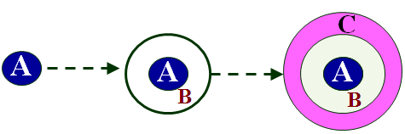
Evolutionary Model
Nilina Bera

Slide 22
Software Life Cycle Models
Advantages of Evolutionary Model
Users get a chance to experiment with a partially developed system:
  much before the full working version is released,
Helps finding exact user requirements:
  much before fully working system is developed.
Core modules get tested thoroughly:
  reduces chances of errors in final product.
  Disadvantages of Evolutionary Model
Often, difficult to subdivide problems into functional units:
  which can be incrementally implemented and delivered.
  evolutionary model is useful for very large problems,
    where it is easier to find modules for incremental implementation.
Nilina Bera

Slide 23
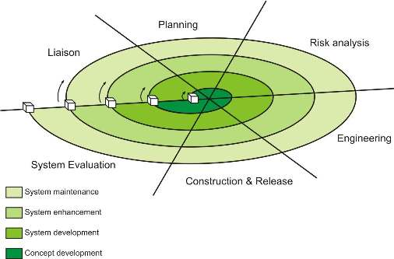
Spiral Model
Nilina Bera

Slide 24
Spiral Model
The spiral model is a risk-driven process model generator for software projects.
Based on the unique risk patterns of a given project, the spiral model guides a team to adopt elements of one or more process models, such as incremental, waterfall, evolutionary or prototyping.
For Projects having many unknown risks that might show up as the development proceeds, the spiral model would be the most appropriate development model to follow.
Nilina Bera

Slide 25
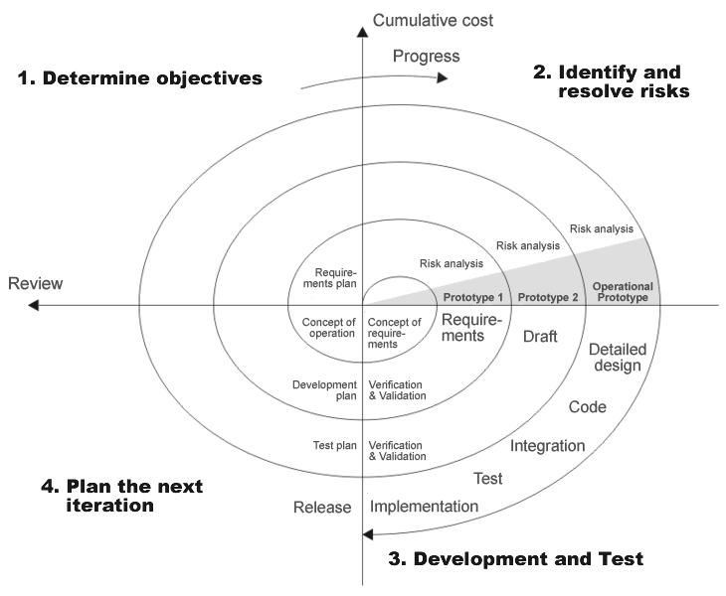
Spiral Model….
Nilina Bera

Slide 26
Spiral Model….
There are no fixed phases in this model, the phases shown in the figure are just examples.
The team must decide:
  how to structure the project into phases.
Start work using some generic model:
  add extra phases
    for specific projects or when problems are identified during a project.
Each loop in the spiral is split into four sectors (quadrants).
Nilina Bera

Slide 27
Spiral Model Application
The Spiral Model is widely used in the software industry as it is in sync with the natural development process of any product, i.e. learning with maturity which involves minimum risk for the customer as well as the development firms.
The following pointers explain the typical uses of a Spiral Model −
When there is a budget constraint and risk evaluation is important.
For medium to high-risk projects.
Long-term project commitment because of potential changes to economic priorities as the requirements change with time.
Customer is not sure of their requirements which is usually the case.
Requirements are complex and need evaluation to get clarity.
New product line which should be released in phases to get enough customer feedback.
Significant changes are expected in the product during the development cycle.
Nilina Bera

Slide 28
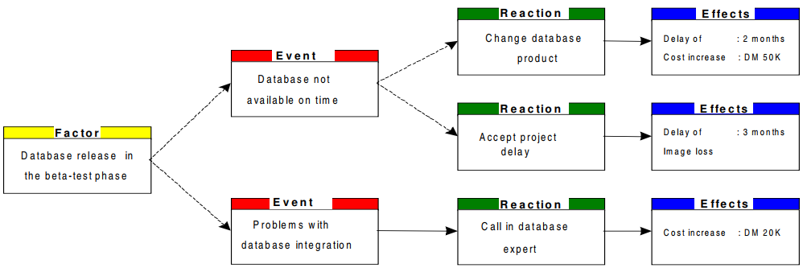
Spiral Model Application : Risk Management for IT and Software Projects (https://itq.ch/pdf/RM__ITProjekteV211.pdf)
What about integrating Oracle 11g XE with Oracle Autonomous Database Cloud is powered by Oracle Database 18c → Low, medium or high risk for HITK with student + staff info....
Nilina Bera

Slide 29
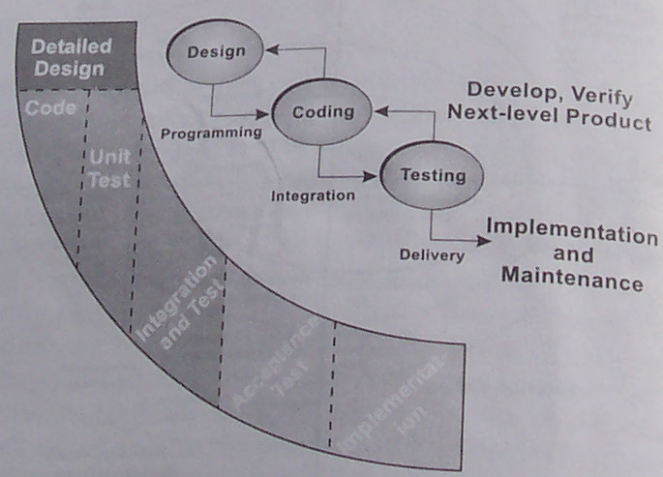
SPIRAL && WATERFALL MODELS
Nilina Bera

Slide 30
Comparison of Different Life Cycle Models
Iterative waterfall model
  most widely used model.
  But, suitable only for well-understood problems.
Prototype model is suitable for projects not well understood:
  user requirements
  technical aspects
Evolutionary model is suitable for large problems:
  can be decomposed into a set of modules that can be incrementally implemented,
  incremental delivery of the system is acceptable to the customer.
The spiral model:
  suitable for development of technically challenging software products that are subject to several kinds of risks.
Nilina Bera

Slide 31
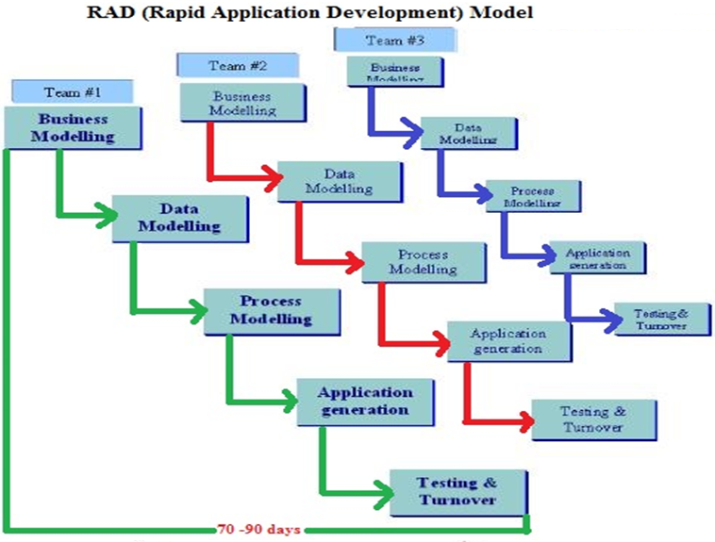
Nilina Bera

Slide 32
RAD
RAD model is Rapid Application Development model. It is a type of incremental model.
In RAD model the components or functions are developed in parallel as if they were mini projects.
The developments are time boxed, delivered and then assembled into a working prototype.
This can quickly give the customer something to see and use and to provide feedback regarding the delivery and their requirements.
Advantages of the RAD model:
Reduced development time.
Increases reusability of components
Quick initial reviews occur
Encourages customer feedback
Integration from very beginning solves a lot of integration issues.
Nilina Bera

Slide 33
When to use RAD model ?
RAD should be used when there is a need to create a system that can be modularized in 2-3 months of time.
It should be used if there’s high availability of designers for modelling and the budget is high enough to afford their cost along with the cost of automated code generating tools.
RAD SDLC model should be chosen only if resources with high business knowledge are available and there is a need to produce the system in a short span of time (2-3 months).
Nilina Bera

Slide 34
Agile
In many software development projects, change is a fact of life.
It may even be the case that the client only has a vague idea of the requirements for the system he asks for.
In recent years, a number of lightweight, agile methods have been proposed that purposely deal with these rapidly changing circumstances.
These methods are built to not ‘waste’ time on expensive planning and design activities early on, but to deliver something valuable to the customer as quickly as possible.
Based on feedback from the user, next steps are then taken.
Agile methods have evolved from approaches such as prototyping and Rapid Application Development that try to dispose of some or all of the drawbacks of the document-driven approach mentioned above.
Nilina Bera

Slide 35
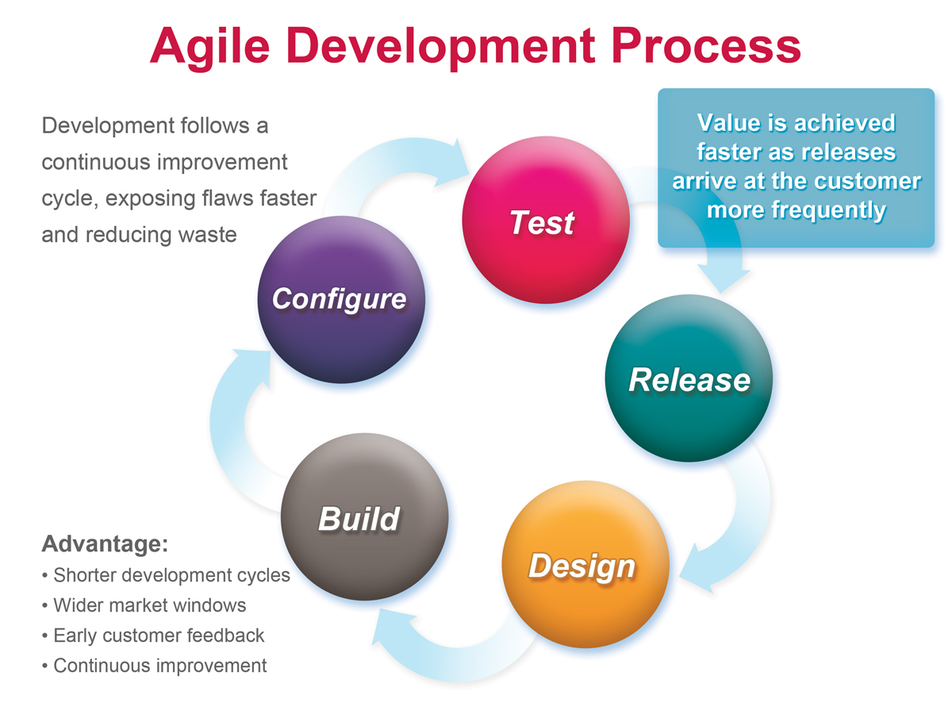
Nilina Bera

Slide 36
Questions →
With regard to Evolutionary development, identify the correct statement.
(a) Evolutionary development usually comes in two flavors; exploratory development, and throw-away prototyping
(b) Very large projects are natural candidates for an evolutionary development based approach
(c) Exploratory development is used in situations where most of the requirements are well understood in advance
(d) One of the strong points of evolutionary development is that it facilitates easy project management, through the high volume of documentation it generates
(e) Often the construction of a throw-away prototype is not followed by a reimplementation of the system using a more structured approach.
Answer : (a)
Reason: Evolutionary development usually comes in two flavors; exploratory development, and throw-away prototyping is the correct statement with respect to Evolutionary development.
Nilina Bera

Slide 37
Questions →
The most important feature of spiral model is
(A) requirement analysis. (B) risk management.
(C) quality management. (D) configuration management.
Ans: B
The model in which the requirements are implemented by category is
(A) Evolutionary Development Model
(B) Waterfall Model
(C) Prototyping
(D) Iterative Enhancement Model
Ans: C
In the spiral model ‘risk analysis’ is performed
(A) In the first loop (B) in the first and second loop
(C) In every loop (D) before using spiral model
Ans: A
Nilina Bera

Slide 38
Questions →
For a well understood data processing application it is best to use
(A) The waterfall model (B) prototyping model
(C) the evolutionary model (D) the spiral model
Ans: A
Each time a defect gets detected and fixed, the reliability of a software product
(A) increases. (B) decreases.
(C) remains constant. (D) cannot say anything.
Ans: A
An object encapsulates
(A) Data (B) Behaviour
(C) State (D) Both Data and behaviour
Ans: D
Nilina Bera

Slide 39
Questions →
The problem that threatens the success of a project but which has not yet happened is:
(A) bug (B) error (C) risk (D) failure
Ans: C
Software consists of
(A) Set of instructions + operating procedures
(B) Programs + documentation + operating procedures
(C) Programs + hardware manuals
(D) Set of programs
Ans: B
Which is the most important feature of spiral model?
(A) Quality management (B) Risk management
(C) Performance management (D) Efficiency management
Ans: B
Nilina Bera

Slide 40
Questions →
Which phase is not available in software life cycle?
(A) Coding (B) Testing
(C) Maintenance (D) Abstraction
Ans: D
Which is not a step of requirement engineering?
(A) Requirements elicitation (B) Requirements analysis
(C) Requirements design (D) Requirements documentation
Ans: C
What are the three generic phases of software engineering?
(A) Definition, development, support
(B) What, how, where
(C) Programming, debugging, maintenance
(D) Analysis, design, testing
Ans: A
Nilina Bera

Slide 41
Questions →
The spiral model of software development
(A) Ends with the delivery of the software product
(B) Is more chaotic than the incremental model
(C) Includes project risks evaluation during each iteration
(D) All of the above
Ans: C
Which of the items listed below is not one of the software engineering layers?
(A) Process (B) Manufacturing
(C) Methods (D) Tools
Ans: B
Which of the following is not an attribute of software engineering
(A) Efficiency. (B) Scalability.
(C) Dependability. (D) Usability.
Ans: C
Nilina Bera

Slide 42
Questions →
What types of models are created during software requirements analysis?
(A) Functional and behavioral (B) Algorithmic and data structure
(C) Architectural and structural (D) Usability and reliability
Ans: A
Software feasibility is based on which of the following
(A) business and marketing concerns
(B) scope, constraints, market
(C) technology, finance, time, resources
(D) technical prowess of the developers
Ans: C
Nilina Bera

